Slide 1
FINAL PROJECT PRESENTATION
Luis Garcia, Angel Ruiz, Jack Witherell

Slide 2
BACKGROUND
Interest in music
DIY Tool System
Learning a powerful software solution
All of these things led to us wanting to make an app that could play music.
Wanted to make an app that could extend the music capabilities of a phone.

Slide 3
BASIC INFORMATION
To be able to use a phone as an instrument
Implement a trigger-like application
Incorporate a visualizer for the audio
Create a compact Pad Controller

Slide 4
PROJECT TIMELINE
We needed to be able to play audio
Seek to an audio position
Store “Pads” as audio playback points
Create a graphical visualizer
Move between activities and make it look good
Fine tuning/ editing pad positions

Slide 5
LIVE DEMO

Slide 6
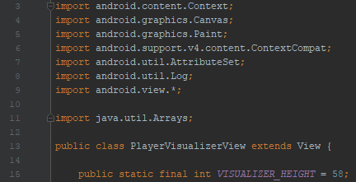
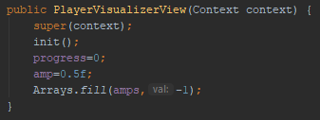
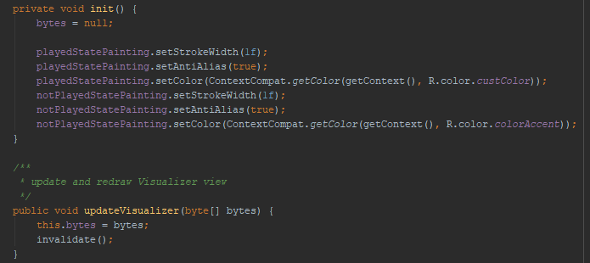
INTERESTING CODE BITS

Slide 7
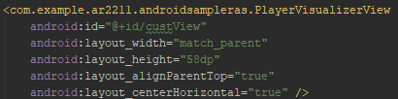
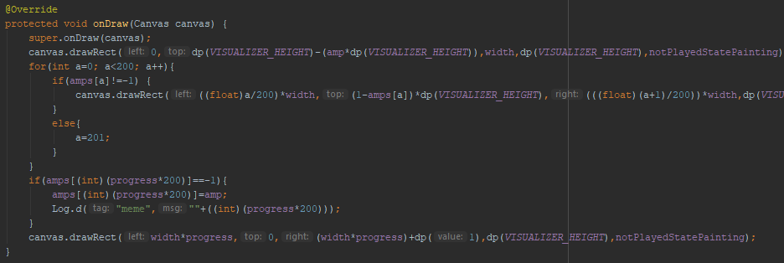
INTERESTING CODE BITS

Slide 8
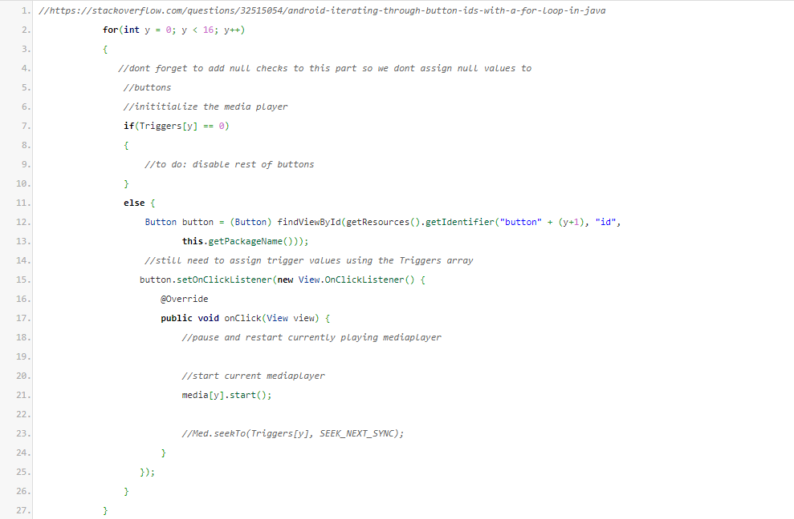
INTERESTING CODE BITS

Slide 9
POST MORTEM - LUIS GARCIA
Array of Media Players vs Array of Triggers
Learning about how URI’s work
Trigger System
Permissions
Programmatically Assigning Buttons
Advice: Intents can only pass strings(at least it’s the easiest), and data binding is hard
I learned how to pass information between different activities.

Slide 10
POST MORTEM - ANGEL RUIZ
Angel, do this slide
Working as a group.
I don’t think I kept my schedule that well.
The interface part of the app was easy to implement.
Passing data through the two activities was difficult.
My advice is to keep going even when you want to give up.
Something I learned is that working in groups can be difficult.

Slide 11
POST MORTEM - JACK WITHERELL
I was surprised by how useful the built in media player functionality was.
I enjoyed creating a custom view- likely a lot I could do with this in the future.
Learned the differences between Xamarin and Android Studio
Surprised at how difficult it is to work with Gradle
I learned what it takes to make clean, reflexive, reusable code in an App Development environment.
Advice: Keep the end goal in mind, and don’t spend a lot of time doing something that hinders your ability to achieve that goal.

Slide 12
FUTURE WORK
I’ve decided that I (Jack) wanted to continue working on this
There are a lot of useful features that I know I could implement
This could easily become a very useful and unique app if I could bypass some roadblocks that we weren’t able to overcome.

